Slide 1

Intro To Data Science Group 6️⃣
Video Game Sales and Performance analysis
By
Sairam Venkatachalam
Amit Subedi
Sriram Sathwik Tippavaram
Bala Krishna Reddy Ragannagari

Slide 2
Overview
The Topic:
The focus of this project revolves around the examination of video game sales and performance
We have used data that has been web-scraped from Metacritic
The Objectives:
Perform Exploratory Data Analysis on the dataset to discover interesting trends and patterns
Conduct Hypothesis Testing to provide answers to our research questions
Research Questions:
What percentage of shooter genre video games have a user score above 8.0?
What are the average user scores for games developed by Nintendo, and how do they compare to other companies? Are these differences statistically significant?
How does the trend in Global Sales by year look like, and how has recency impacted the popularity in platforms?
Is there a statistically significant difference in mean sales for games with a rating of 7.5 or higher compared to those with a rating below 7.5? Can we determine a critical score that leads to higher sales?

Slide 3
Structure of the Dataset
Game Specific
Scores
Sales
Platform
User Score
North America
Developer
Critic Score
Europe
Genre
Japan
Year of Release
Global

Slide 4
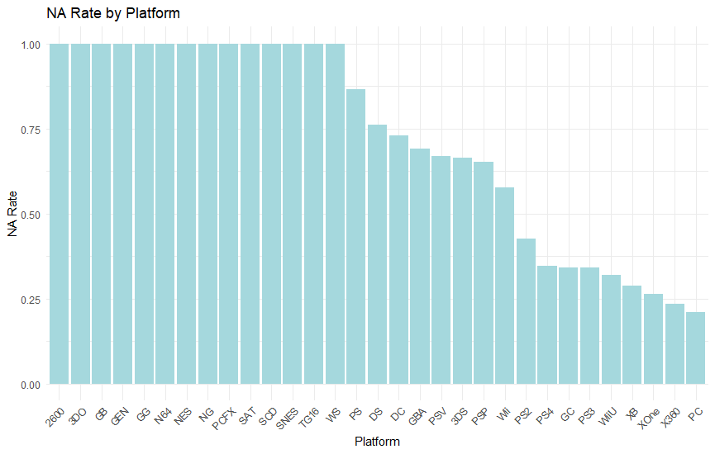
Data Cleaning – Identifying missing observations
A Total of 6826 out of 16719 observations were complete with all variables. This is due to the fact that the data source is web scraped from metacritic which does not capture all platforms
The remaining observations had missing values for user scores, critic scores, year of release etc
In order to evaluate if these missing observations were systematic, the NA Rate was calculated by platform.
As shown in the figure, there is a clear capture issue for certain platforms, while other more poplar platforms like PC and Xbox 360 have an NA Rate of less than 25%

Slide 5
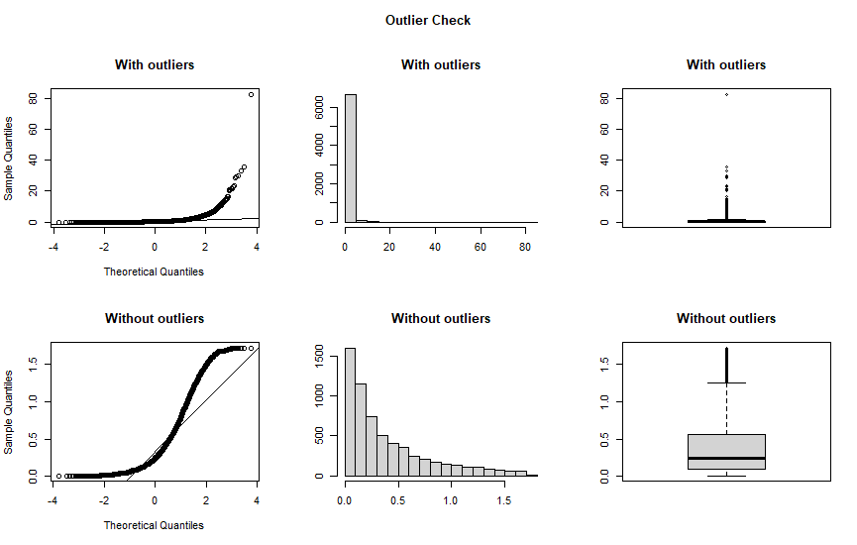
Data Cleaning – Outlier Handing
We identified outliers in the Global Sales data with significantly higher sales figures compared to most of the dataset.
As our analysis focused on comparing the means of different groups, the presence of these outliers could affect our results.
The original data, including the outliers, exhibited a substantial right-skew in both the histogram and boxplot, potentially affecting the validity of our statistical analyses.
By removing these outliers, the data became more normally distributed; although some right-skewness remains due to the inherent concentration of sales values near low values.

Slide 6
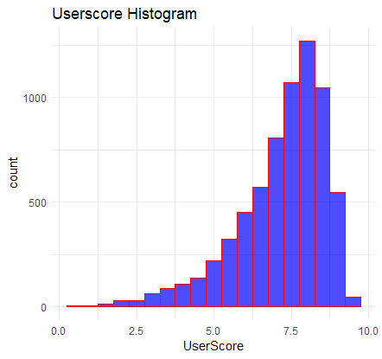
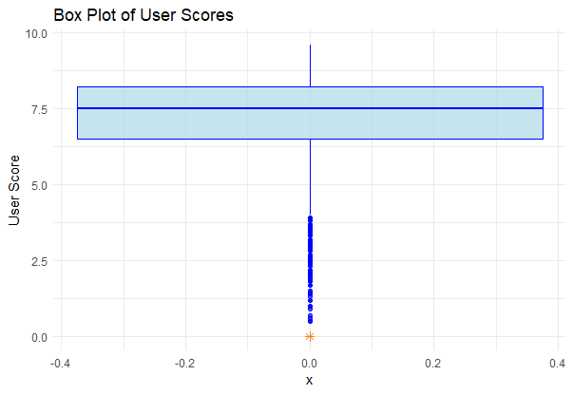
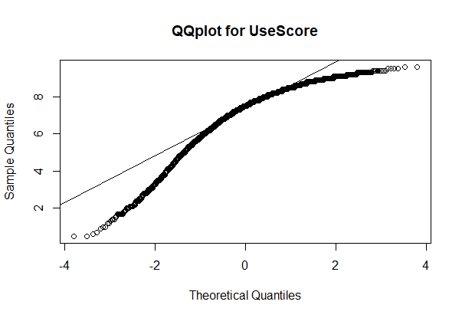
Exploratory Data Analysis – User Score
The histogram of User Scores reveals a left-skewed pattern, due to the fact that majority of the scores are high
The QQ plots closely follows the normal distribution line. This implies that the data is approximately normally distributed

Slide 7
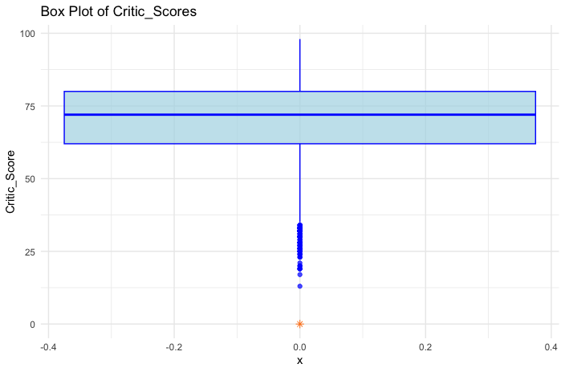
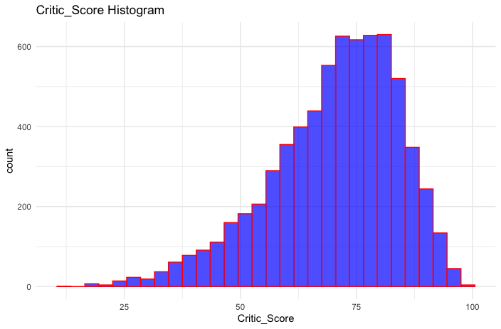
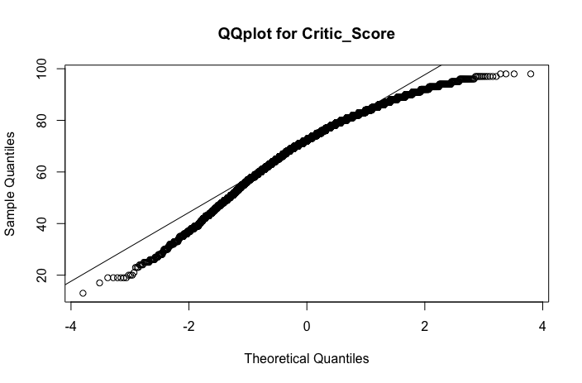
Exploratory Data Analysis – Critic Score
The histogram for Critic Score also reveals a left-skewed pattern
The QQ plots once again closely follow the normal distribution line

Slide 8
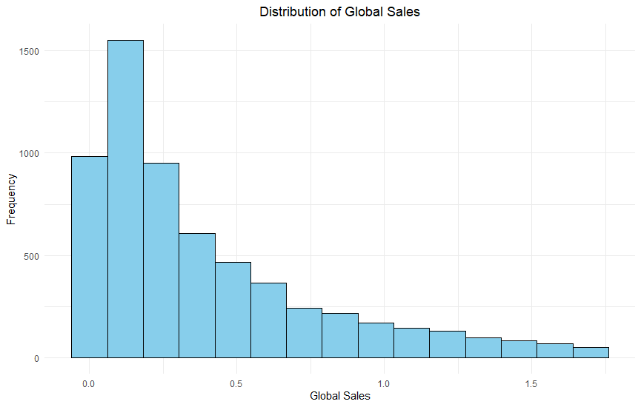
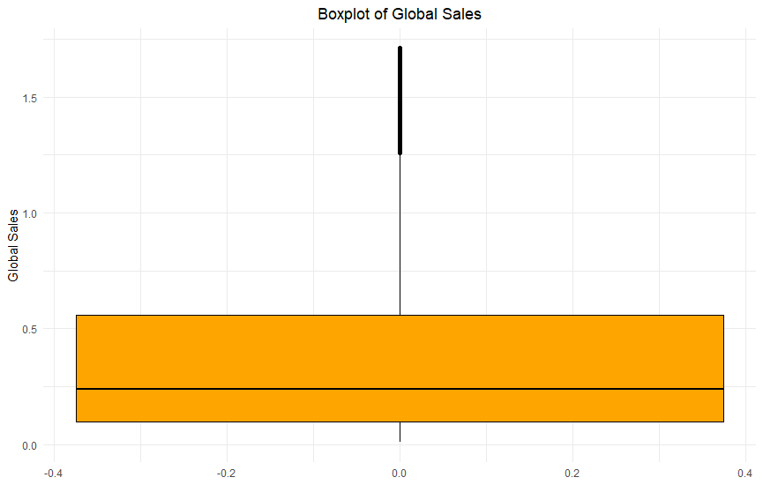
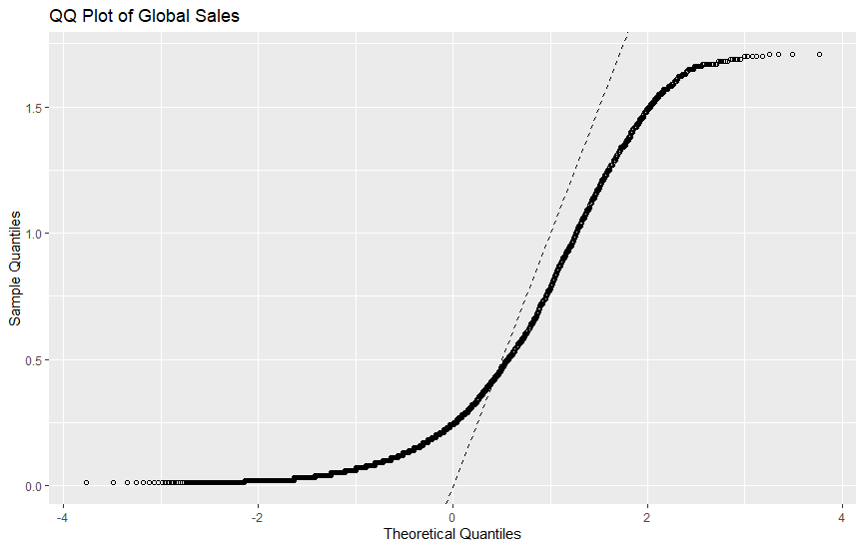
Exploratory Data Analysis - Sales
The histogram of global sales in millions of shows a right-skewed distribution. This skewness arises from the majority of the data points having low sales, primarily concentrated near zero
The QQ plot further emphasizes the right-skewed nature of the global sales data, with the majority of games having low sales and a few outliers achieving exceptionally high sales figures.

Slide 9
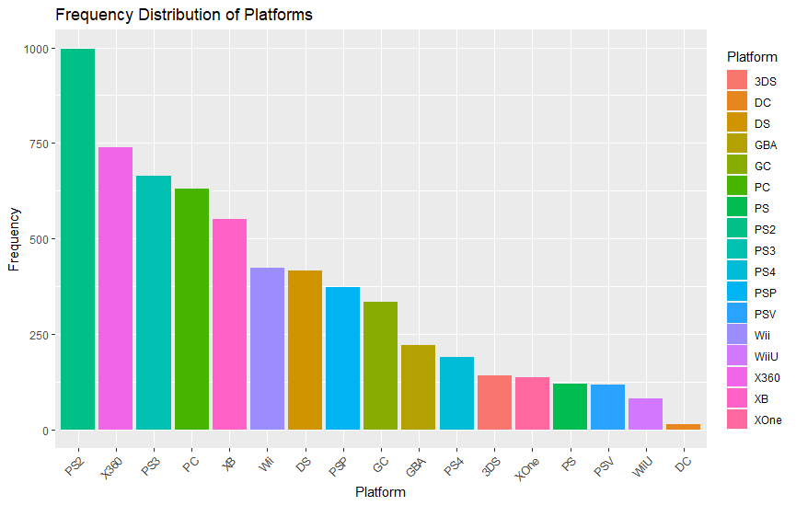
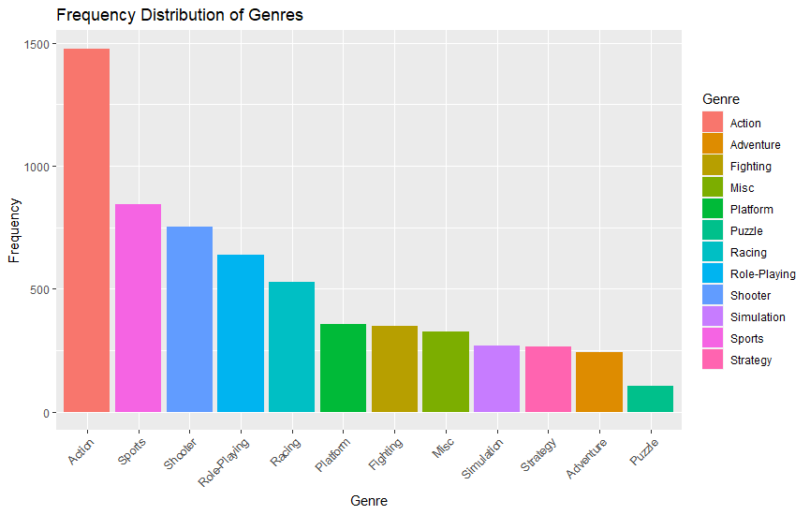
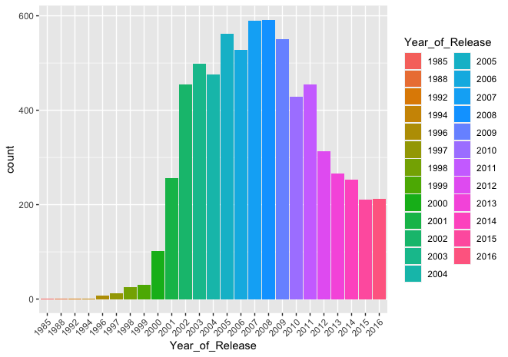
Exploratory Data Analysis – Categorical Variables

Slide 10
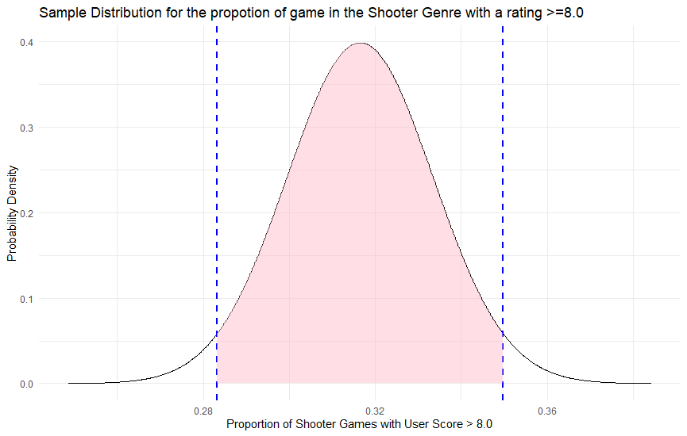
Research Question 1 – Proportion of Shooter Games with a User Score of >=8.0
Goal: To estimate the proportion of all shooter games with a user rating of >= 8.0
Findings: The 95% confidence interval for this proportion falls between 0.283 to 0.350 with the sample proportion being 0.316. This indicates that the true proportion of highly-rated shooter games likely lies within this range
Implications: These results suggest that the presence of significant proportion of highly-rated shooter games
The proportion of all games with a user rating >=8.0 is around 0.337 .

Slide 11
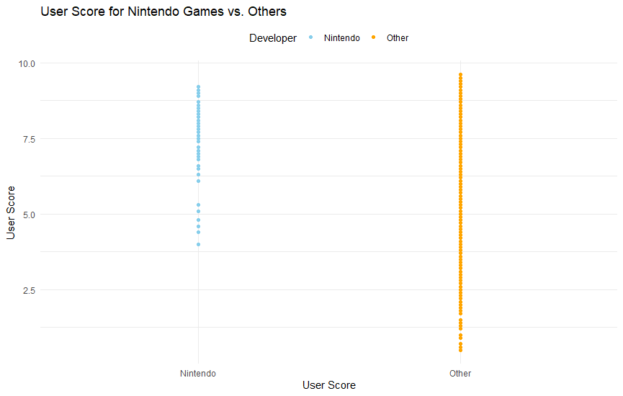
Research Question 2 – Nintendo vs Non-Nintendo User Score comparison
Goal: To compare the User Scores for games developed by Nintendo vs others
Findings: The mean User Scores for games developed by Nintendo is 8.019 as opposed to 7.176 for Non-Nintendo games
This difference of means corresponds to a p value of 2.48e-10
Implications: Given the order of the p value, we can conclude that this result is highly statistically significant
The scatter plot also highlights this difference

Slide 12
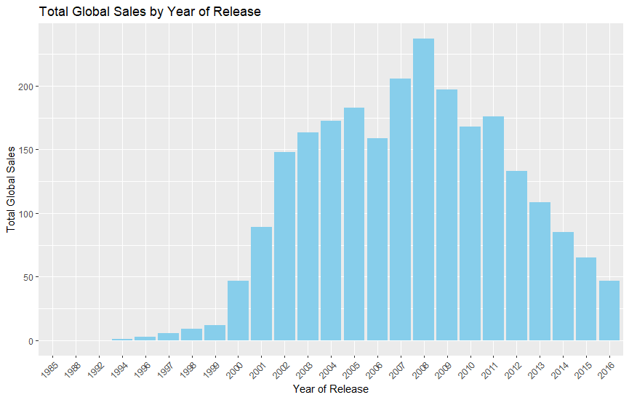
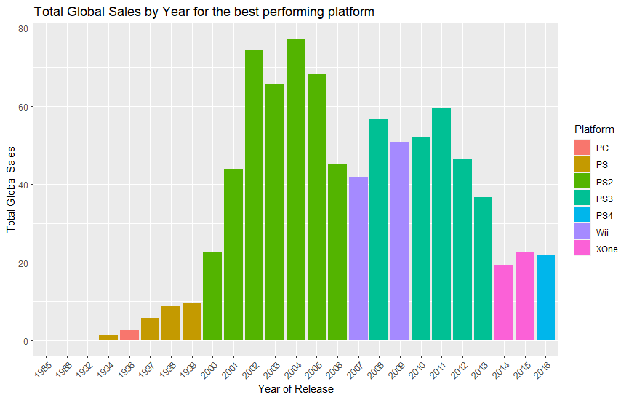
Research Question 3– What is the Trend in global sales by year ?
Goal: To analyze the trend of global sales by year to identify patterns
Findings: In the late 90s and early 00s, the video game industry experienced an explosive growth in total global sales. This period marked a significant rise in the popularity and sales of video games.
During this growth phase, PlayStation was the leading platform, contributing significantly to the industry's success. PS2 had a substantial impact on the gaming market.
After 2008, there was a gradual decline in the global sales, partly due to the recession and also due to the trend shift towards mobile gaming

Slide 13
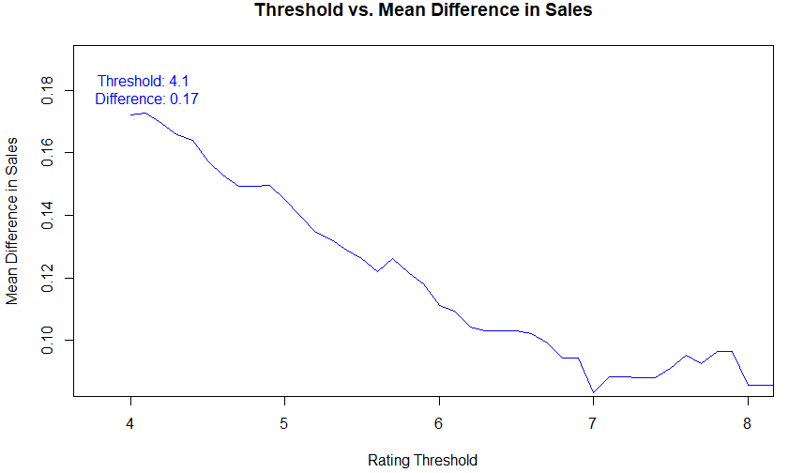
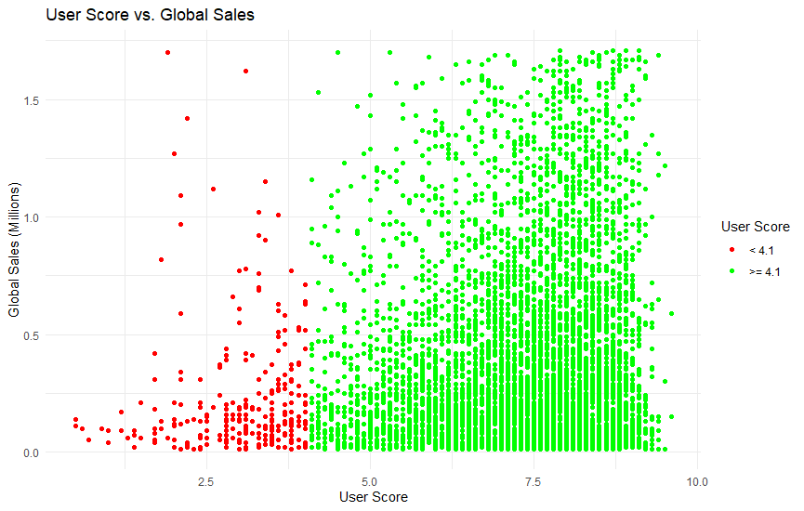
Research Question 4- User scores vs Global Sales
Goal: To compare the global sales for games with a rating of >=7.5 vs others. Additionally, to find a threshold rating which leads to the biggest sales difference
Findings: There is a difference of 91.3 Thousand copies in the means of games with a user rating of >=7.5 vs <7.5. The p value associated with this test is 5.347e-20
When looking at different rating thresholds, we notice a decline in the difference of means between both groups, with the 4.1 rating producing the highest difference
Implications: These results suggest that the global sales may only be weakly related to the number of global copies sold. A quick look at the correlation between both shows a value of 0.145 confirming this

Slide 14
Conclusion and Next steps
Conclusions:
We have obtained statistically significant results for our research questions, shedding some light on the relationships between different variables and the differences in groups
However, it's essential to acknowledge certain caveats:
Sample Error: Our data collection process, relying on web scraping, introduced potential inaccuracies and omissions.
Limited Platforms: The exclusion of certain platforms from Metacritic data limited the comprehensiveness of our analysis.
Despite these limitations, our findings provide valuable insights into the prevalent patterns and the relationships between different factors in the gaming industry
Further Research
Multivariate Analysis: Our next phase of research will involve a more detailed multivariate analysis. This will enable us to explore complex relationships between multiple variables, such as the impact of both the publisher and the platform on the global sales. This will offer a deeper understanding of the factors impacting video game performance.
Predictive Modeling & Classification: We will embark on predictive modeling and classification techniques to predict sales trends, identify market segments, and predict game success

